Slide 1
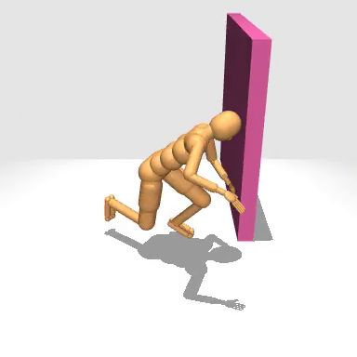
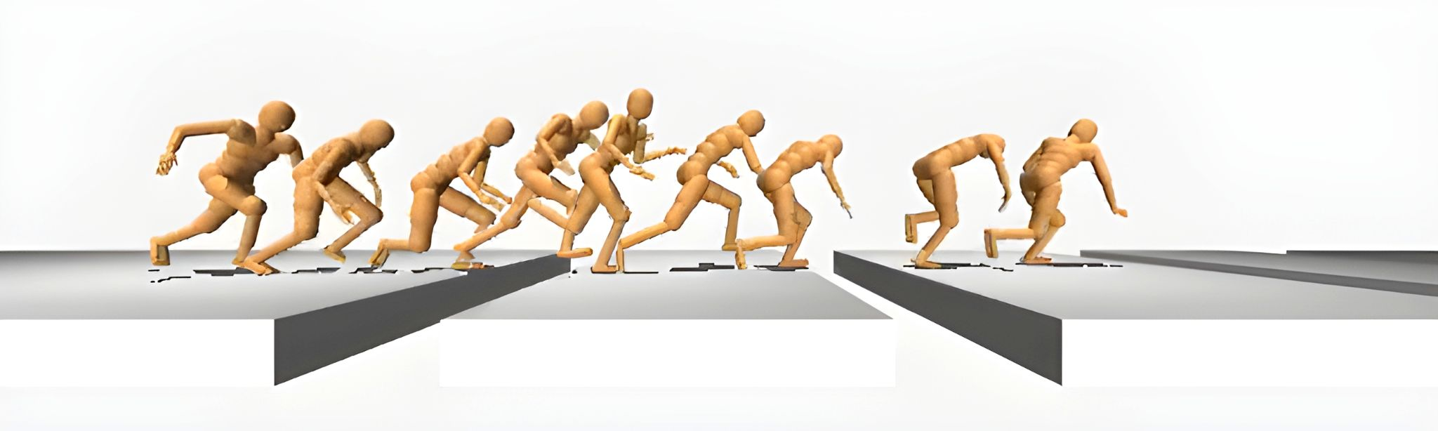
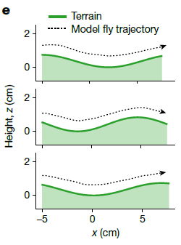
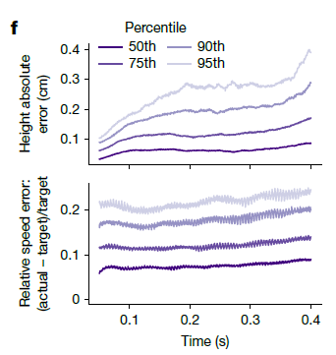
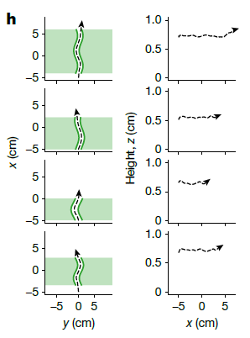
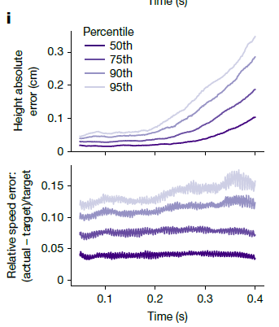
a
Eye camera input
Task input:
Target running speed
Target running direction
b
c
Visual network
(CNN)
Observations:
Proprioception
Vestibular
High-level
controller policy
Steering
command
Pretrained
low-level
controller
Leg
frequency
control
LPG
Human model in MuJoCo
physics simulator
Reward:
Target running speed
Target running direction
Body pitch angle
Centre of sidewalk position
Contact with terrain terminates episode
Actions
Left eye
Right eye
d
Corridor task
g
Notes:
fig_4
Leg Patten Generator (LPG)

